Slide 1
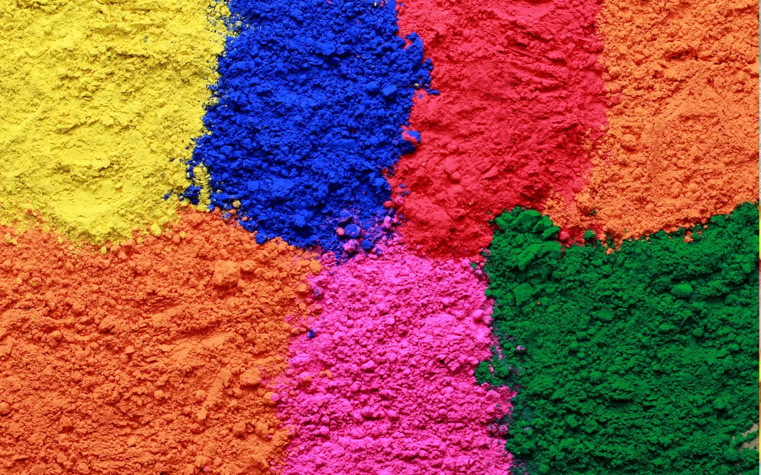
Decision Tree
Sukanta Ghosh
Asst. Professor

Slide 2
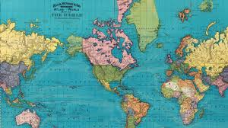

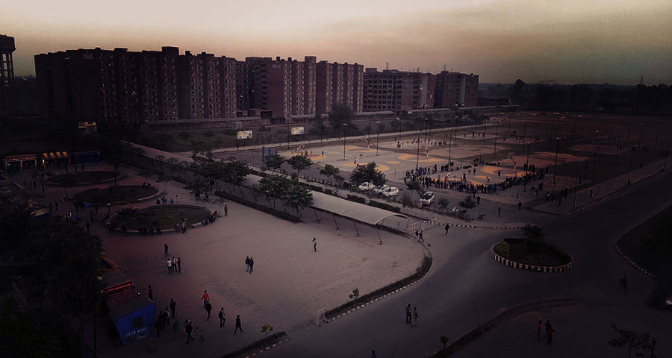
What we are going to learn?
What is decision Tree?
Terms related to Decision Tree
Different types of splitting criteria
Pros/Cons of Decision Tree
Python implementation of Decision Tree

Slide 3
Decision Tree Algorithm
Supervised learning algorithms
Used to solve both regression and classification.
More useful for classification.
Goal is to create a training model that can use to predict the class or value of the target variable by learning simple decision rules inferred from prior data(training data).
Decision tree is a tree structured classifier.
Tree has node.
Two types of nodes:
Decision Nodes: Specify a choice/test, based on which you choose your movement.
Leaf Nodes: Indicate classification/value of the example

Slide 4
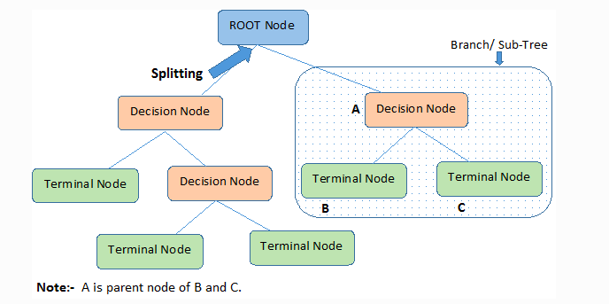
Nodes of a Tree

Slide 5
Types of Decision Trees
Types of decision trees are based on the type of target variable we have. It can be of two types:
Categorical Variable Decision Tree: Decision Tree which has a categorical target variable then it called a Categorical variable decision tree.
Predict whether a customer will pay his renewal premium with an insurance company (yes/ no).
Continuous Variable Decision Tree: Decision Tree has a continuous target variable then it is called Continuous Variable Decision Tree.
Predict customer income based on occupation, product, and various other variables.

Slide 6
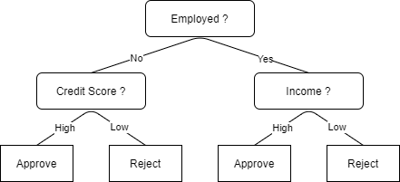
Lets take an example: Loan Approval System

Slide 7
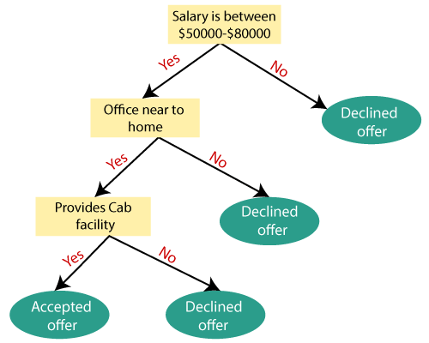
Lets take an example: Job Offer Decision

Slide 8
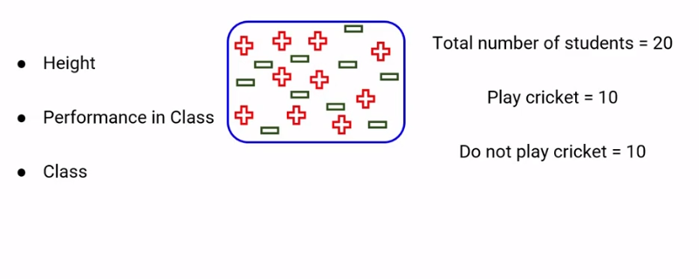
Decision Tree Explanation

Slide 9
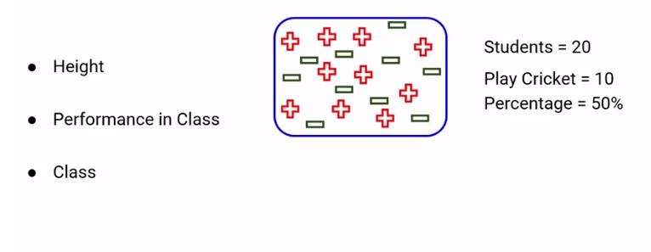
Decision Tree Explanation

Slide 10
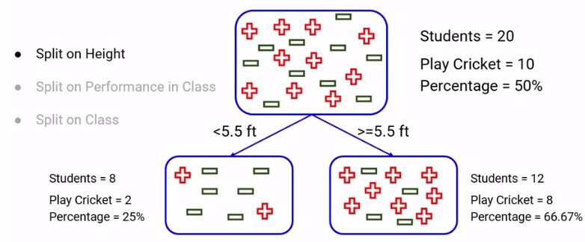
Decision Tree Explanation

Slide 11
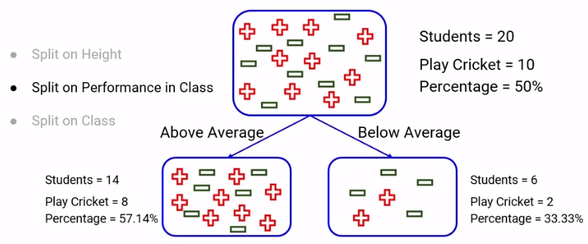
Decision Tree Explanation

Slide 12
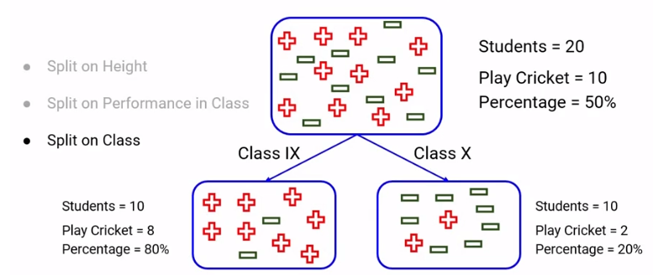
Decision Tree Explanation

Slide 13
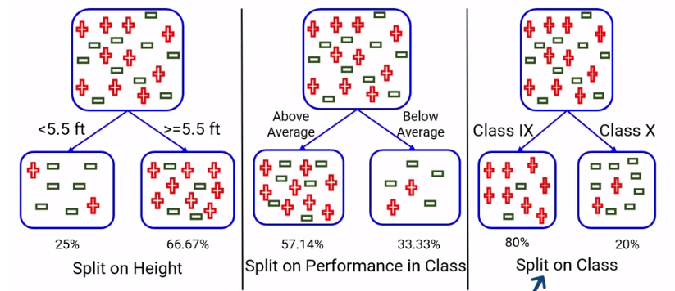
Which one will you choose and why?

Slide 14
Question
What is the basic idea behind choosing the best split in the data?
Resultant nodes should be as heterogeneous as possible
Resultant nodes should be as Homogeneous as possible
The resultant nodes should have the exact same number of observations

Slide 15
Question
What is the basic idea behind choosing the best split in the data?
Resultant nodes should be as heterogeneous as possible
Resultant nodes should be as Homogeneous as possible
The resultant nodes should have the exact same number of observations

Slide 16
Question
Only continuous variables can be used to split the data in decision trees. True or false?
True
False

Slide 17
Question
Only continuous variables can be used to split the data in decision trees. True or false?
True
False

Slide 18
What would be the Ideal Split ? Any guesses !

Slide 19
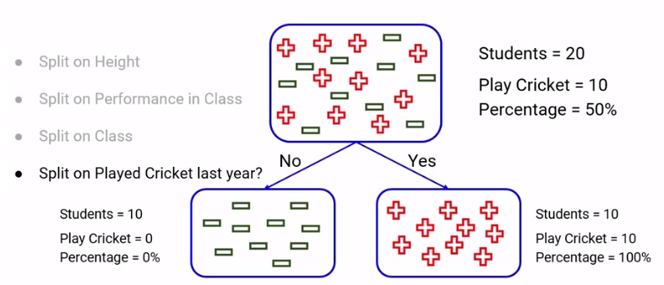
Ideal Case

Slide 20
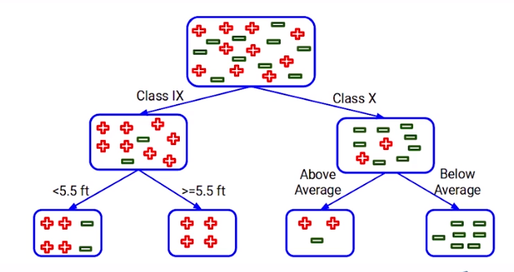
Multiple Splits

Slide 21
Lets freeze the mind
How do we decide which split is better?
Which splits should be first or which split should be second and so on?
What is the sequence the split should be made?

Slide 22
Need to defrost now
There are various techniques to decide the purity of the node, based on this we decide every split.

Slide 23
Question
What does an ideal pure node have?
Choose only ONE best answer.
Equal distribution of all classes
100% of one class and 0 of other classes
Distribution of classes does not decide the purity

Slide 24
Question
What does an ideal pure node have?
Choose only ONE best answer.
Equal distribution of all classes
100% of one class and 0 of other classes
Distribution of classes does not decide the purity

Slide 25
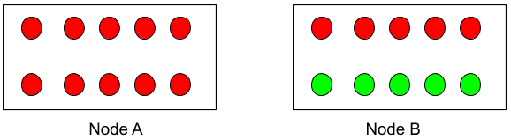
Question
Which of the following is a more pure node?
Node A
Node B

Slide 26
Question
Which of the following is a more pure node?
Node A
Node B

Slide 27
Terminologies Related to Decision Trees

Slide 28
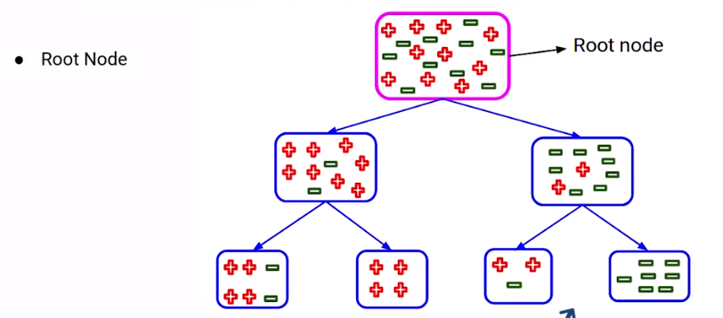
Terminologies Related to Decision Trees

Slide 29
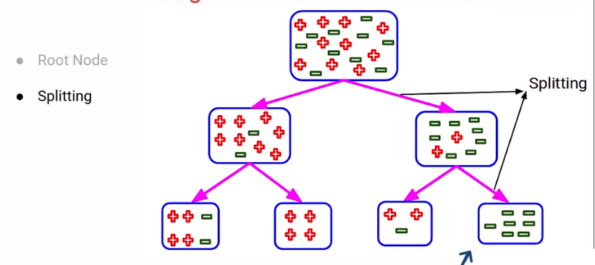
Terminologies Related to Decision Trees

Slide 30
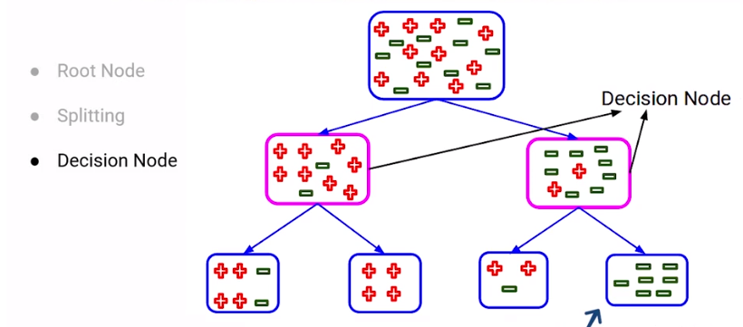
Terminologies Related to Decision Trees

Slide 31
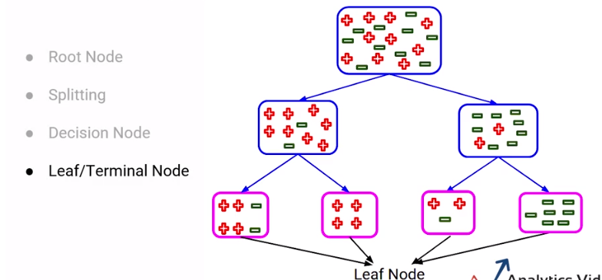
Terminologies Related to Decision Trees

Slide 32
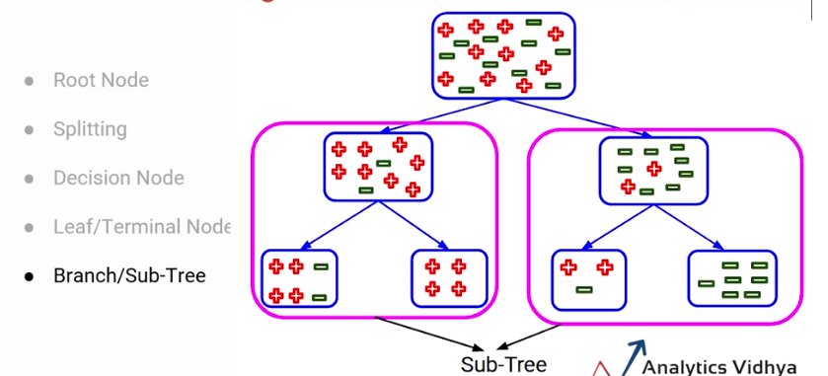
Terminologies Related to Decision Trees

Slide 33
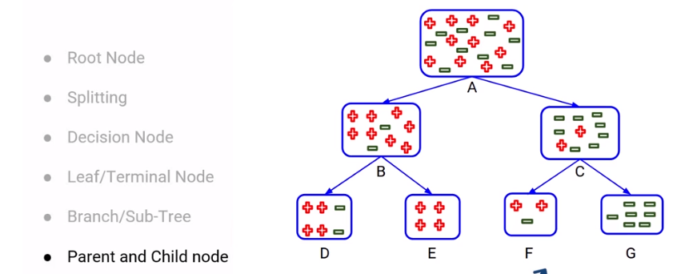
Terminologies Related to Decision Trees

Slide 34
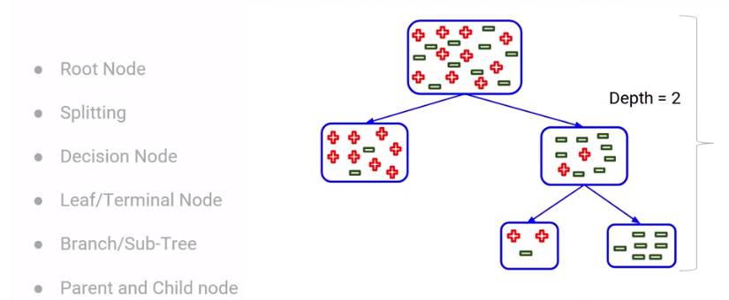
Terminologies Related to Decision Trees

Slide 35
Select the Best Split Point

Slide 36
How to Select the Best Split Point in Decision Trees
Decision tree splits the nodes on all the variables.
Selects the splits which results in most homogeneous sub-nodes.

Slide 37
Node splitting in decision tree
There are multiple ways of doing this, which can be broadly divided into two categories based on the type of target variable:
Continuous Target Variable
Reduction in Variance
Categorical Target Variable
Gini Impurity
Information Gain
Chi-Square

Slide 38
GINI Impurity

Slide 39
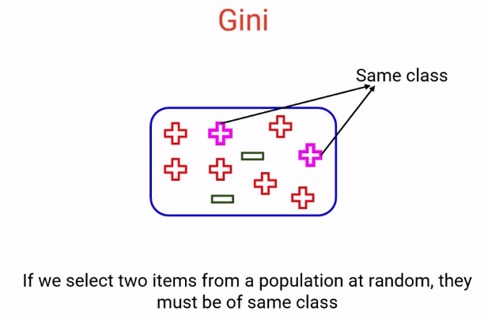
GINI Impurity
GINI Impurity = 1 – Gini

Slide 40
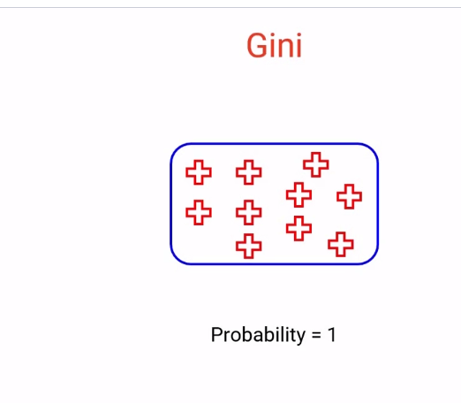
Gini ranges from 0 to 1 as it is probability. More value of node means higher purity. Less value means less purity.

Slide 41
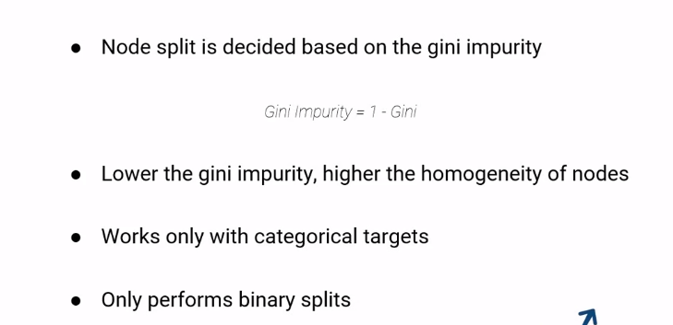
Properties of Gini Impurity

Slide 42
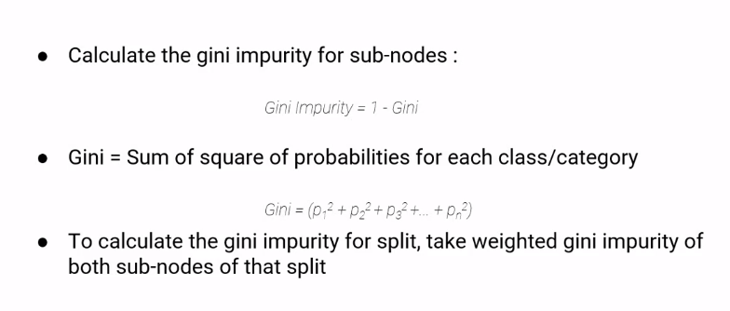
Steps to calculate Gini impurity

Slide 43
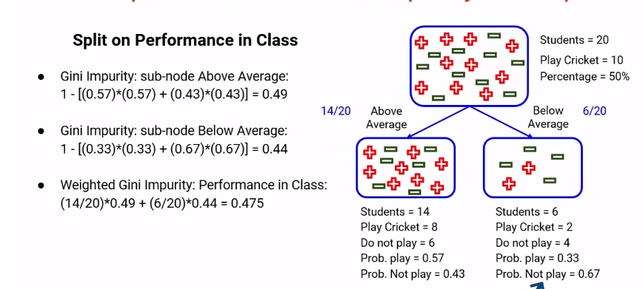
Steps to calculate Gini impurity

Slide 44
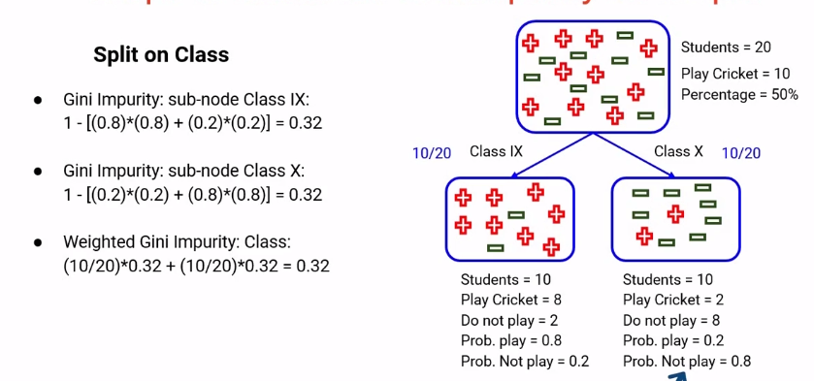
Steps to calculate Gini impurity

Slide 45
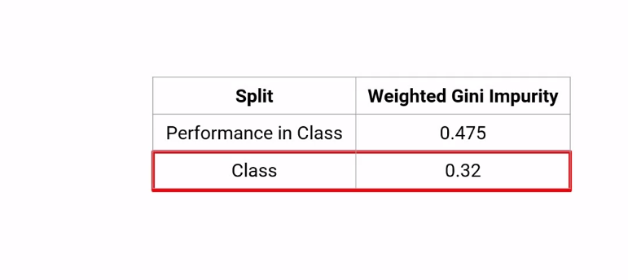
Steps to calculate Gini impurity

Slide 46
Questions
Gini can be used for multiclass classification problems. True or false?
Choose only ONE best answer.
True
False

Slide 47
Answer
Gini can be used for multiclass classification problems. True or false?
Choose only ONE best answer.
True
False

Slide 48
Question
What does Gini value of 1 represent?
The nodes are homogeneous
The nodes are heterogeneous

Slide 49
Answer
What does Gini value of 1 represent?
The nodes are homogeneous
The nodes are heterogeneous

Slide 50
Question
The value of Gini Impurity should be as high as possible in any given split. True or false?
True
False

Slide 51
Answer
The value of Gini Impurity should be as high as possible in any given split. True or false?
True
False

Slide 52
Create a decision tree using GINI Impurity method.
Day | Weather | Temperature | Humidity | Wind | Play?
1 | Sunny | Hot | High | Weak | No
2 | Cloudy | Hot | High | Weak | Yes
3 | Sunny | Mild | Normal | Strong | Yes
4 | Cloudy | Mild | High | Strong | Yes
5 | Rainy | Mild | High | Strong | No
6 | Rainy | Cool | Normal | Strong | No
7 | Rainy | Mild | High | Weak | Yes
8 | Sunny | Hot | High | Strong | No
9 | Cloudy | Hot | Normal | Weak | Yes
10 | Rainy | Mild | High | Strong | No

Slide 53
Create a decision tree using GINI Impurity method.
A property owner is faced with a choice of:
(a) A large-scale investment (A) to improve her flats. This could produce a substantial pay-off in terms of increased revenue net of costs but will require an investment of £1,400,000. After extensive market research it is considered that there is a 40% chance that a pay-off of £2,500,000 will be obtained, but there is a 60% chance that it will be only £800,000.
(b) A smaller scale project (B) to re-decorate her premises. At £500,000 this is less costly but will produce a lower pay-off. Research data suggests a 30% chance of a gain of £1,000,000 but a 70% chance of it being only £500,000.
(c) Continuing the present operation without change (C). It will cost nothing, but neither will it produce any pay-off. Clients will be unhappy and it will become harder and harder to rent the flats out when they become free.
How will a decision tree help the taking of the decision?

Slide 54
Chi-Square Method

Slide 55
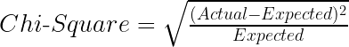
Chi-Square
Chi-square is another method of splitting nodes in a decision tree for datasets having categorical target values.
It can make two or more than two splits.
It works on the statistical significance of differences between the parent node and child nodes.
Properties of Chi-Square:
Works only with categorical variables.
Higher the Chi-Square value, higher the homogeneity of node.

Slide 56
Steps to split a decision tree using Chi-Square
For each split, individually calculate the Chi-Square value of each child node by taking the sum of Chi-Square values for each class in a node
Calculate the Chi-Square value of each split as the sum of Chi-Square values for all the child nodes
Select the split with higher Chi-Square value
Until you achieve homogeneous nodes, repeat steps 1-3

Slide 57
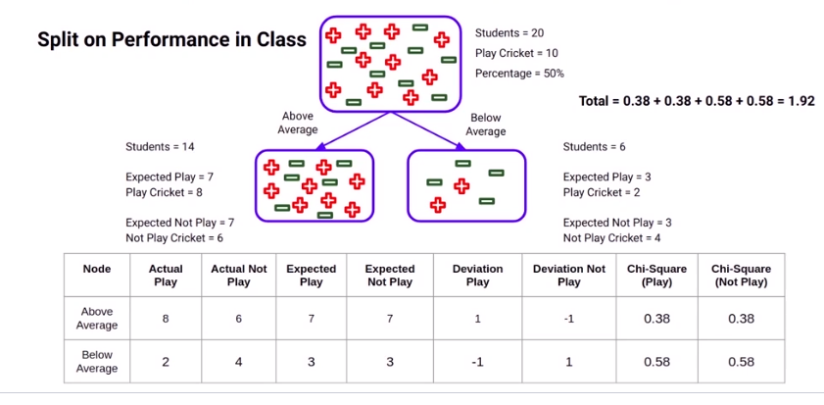
Steps to calculate Chi-Square

Slide 58
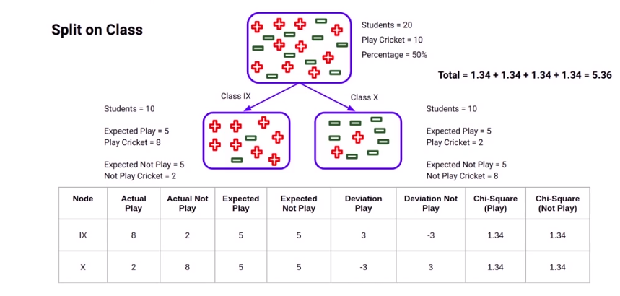
Steps to calculate Chi-Square

Slide 59
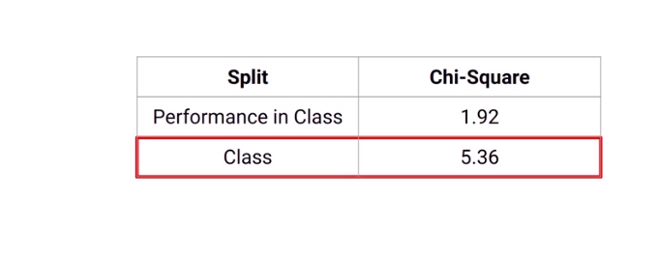
Steps to calculate Chi-Square

Slide 60
Question
What does a high value of Chi-square indicate?
Node follows the distribution of parent node
Node distribution is very different from parent node
Node is more homogeneous than the parent
Node is less homogeneous than the parent
I only
I and III
II and III
IV only

Slide 61
Answer
What does a high value of Chi-square indicate?
Node follows the distribution of parent node
Node distribution is very different from parent node
Node is more homogeneous than the parent
Node is less homogeneous than the parent
I only
I and III
II and III
IV only

Slide 62
Question
Chi-square checks for the statistical significance of the similarity between the child node and the parent node. True or false?
True
False

Slide 63
Answer
Chi-square checks for the statistical significance of the similarity between the child node and the parent node. True or false?
True
False

Slide 64
Question
Which of the following is incorrect about Chi-Square?
Works only with the Categorical Target variable
Can only perform binary split
Higher the chi-square value, higher the homogeneity

Slide 65
Answer
Which of the following is incorrect about Chi-Square?
Works only with the Categorical Target variable
Can only perform binary split
Higher the chi-square value, higher the homogeneity

Slide 66
Create a decision tree using Chi-Square method.
Day | Weather | Temperature | Humidity | Wind | Play?
1 | Sunny | Hot | High | Weak | No
2 | Cloudy | Hot | High | Weak | Yes
3 | Sunny | Mild | Normal | Strong | Yes
4 | Cloudy | Mild | High | Strong | Yes
5 | Rainy | Mild | High | Strong | No
6 | Rainy | Cool | Normal | Strong | No
7 | Rainy | Mild | High | Weak | Yes
8 | Sunny | Hot | High | Strong | No
9 | Cloudy | Hot | Normal | Weak | Yes
10 | Rainy | Mild | High | Strong | No

Slide 67
Create a decision tree using Chi-Square method.
A property owner is faced with a choice of:
(a) A large-scale investment (A) to improve her flats. This could produce a substantial pay-off in terms of increased revenue net of costs but will require an investment of £1,400,000. After extensive market research it is considered that there is a 40% chance that a pay-off of £2,500,000 will be obtained, but there is a 60% chance that it will be only £800,000.
(b) A smaller scale project (B) to re-decorate her premises. At £500,000 this is less costly but will produce a lower pay-off. Research data suggests a 30% chance of a gain of £1,000,000 but a 70% chance of it being only £500,000.
(c) Continuing the present operation without change (C). It will cost nothing, but neither will it produce any pay-off. Clients will be unhappy and it will become harder and harder to rent the flats out when they become free.
How will a decision tree help the taking of the decision?

Slide 68
Information Gain Method

Slide 69
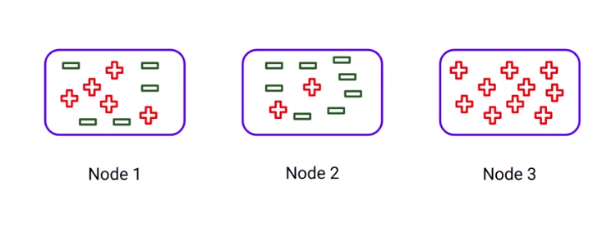
Information Gain

Slide 70
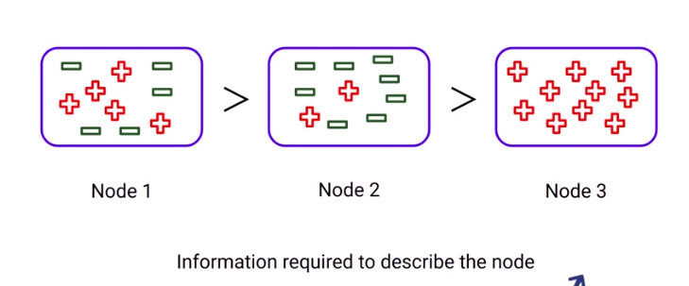
Information Gain

Slide 71
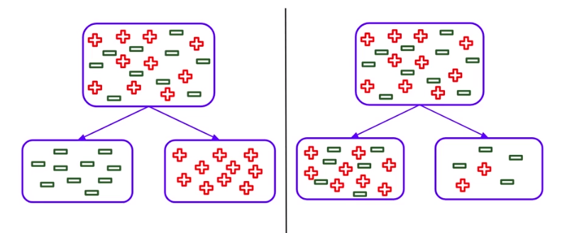
Information Gain

Slide 72
Information Gain
Information Gain is used for splitting the nodes when the target variable is categorical.
It works on the concept of the entropy and is given by:
Entropy is used for calculating the purity of a node.
Lower the value of entropy, higher is the purity of the node.
The entropy of a homogeneous node is zero.
Since we subtract entropy from 1, the Information Gain is higher for the purer nodes with a maximum value of 1.

Slide 73
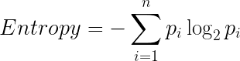
Information Gain
The formula for calculating the entropy:

Slide 74
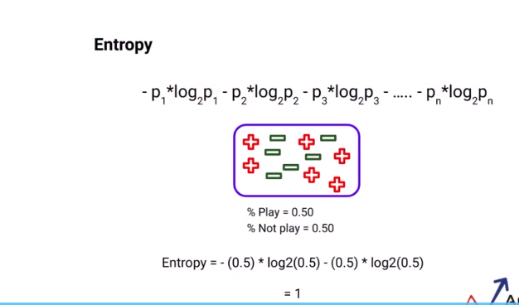
Entropy

Slide 75
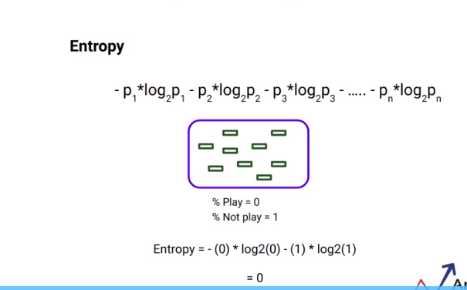
Entropy

Slide 76
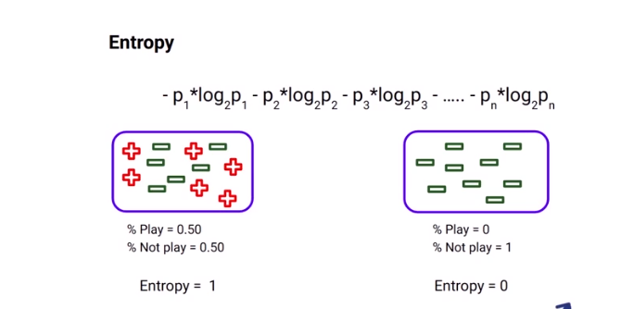
Entropy

Slide 77
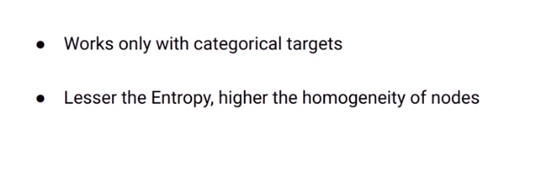
Property of Entropy

Slide 78
Steps to split a decision tree using Information Gain
For each split, individually calculate the entropy of each child node
Calculate the entropy of each split as the weighted average entropy of child nodes
Select the split with the lowest entropy or highest information gain
Until you achieve homogeneous nodes, repeat steps 1-3

Slide 79
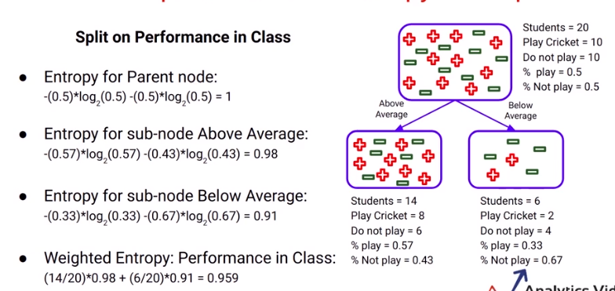
Calculation of Entropy

Slide 80
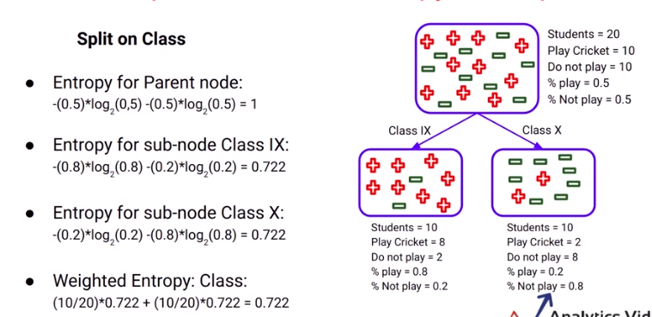
Calculation of Entropy

Slide 81
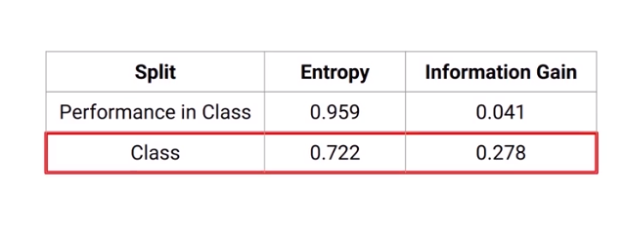
Choosing the best split

Slide 82
Question
After splitting, Information Gain is more than that of the parent node. What does this mean?
Parent node is more homogeneous
Child nodes are more homogeneous
Parent node and child node have the same distribution

Slide 83
Answer
After splitting, Information Gain is more than that of the parent node. What does this mean?
Parent node is more homogeneous
Child nodes are more homogeneous
Parent node and child node have the same distribution

Slide 84
Create a decision tree using Information gain method.
Day | Weather | Temperature | Humidity | Wind | Play?
1 | Sunny | Hot | High | Weak | No
2 | Cloudy | Hot | High | Weak | Yes
3 | Sunny | Mild | Normal | Strong | Yes
4 | Cloudy | Mild | High | Strong | Yes
5 | Rainy | Mild | High | Strong | No
6 | Rainy | Cool | Normal | Strong | No
7 | Rainy | Mild | High | Weak | Yes
8 | Sunny | Hot | High | Strong | No
9 | Cloudy | Hot | Normal | Weak | Yes
10 | Rainy | Mild | High | Strong | No

Slide 85
Create a decision tree using Information gain method.
A property owner is faced with a choice of:
(a) A large-scale investment (A) to improve her flats. This could produce a substantial pay-off in terms of increased revenue net of costs but will require an investment of £1,400,000. After extensive market research it is considered that there is a 40% chance that a pay-off of £2,500,000 will be obtained, but there is a 60% chance that it will be only £800,000.
(b) A smaller scale project (B) to re-decorate her premises. At £500,000 this is less costly but will produce a lower pay-off. Research data suggests a 30% chance of a gain of £1,000,000 but a 70% chance of it being only £500,000.
(c) Continuing the present operation without change (C). It will cost nothing, but neither will it produce any pay-off. Clients will be unhappy and it will become harder and harder to rent the flats out when they become free.
How will a decision tree help the taking of the decision?

Slide 86
Variance Method

Slide 87
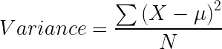
Variance
Reduction in Variance is a method for splitting the node used when the target variable is continuous, i.e., regression problems.
It is so-called because it uses variance as a measure for deciding the feature on which node is split into child nodes.
Variance is used for calculating the homogeneity of a node.
If a node is entirely homogeneous, then the variance is zero.

Slide 88
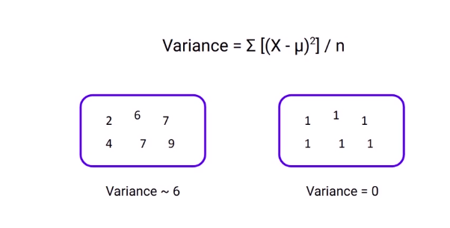
Variance

Slide 89
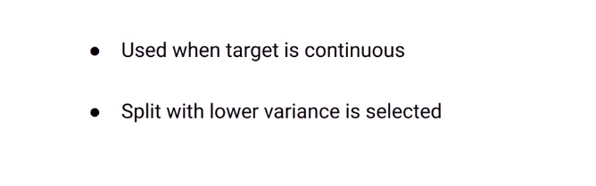
Properties of variance

Slide 90
Steps to split a decision tree using reduction in variance
For each split, individually calculate the variance of each child node
Calculate the variance of each split as the weighted average variance of child nodes
Select the split with the lowest variance
Perform steps 1-3 until completely homogeneous nodes are achieved

Slide 91
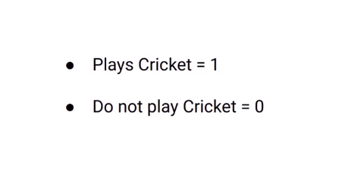
Steps to calculate the variance

Slide 92
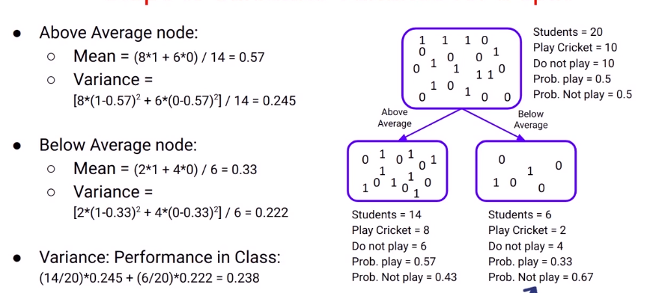
Steps to calculate the variance

Slide 93
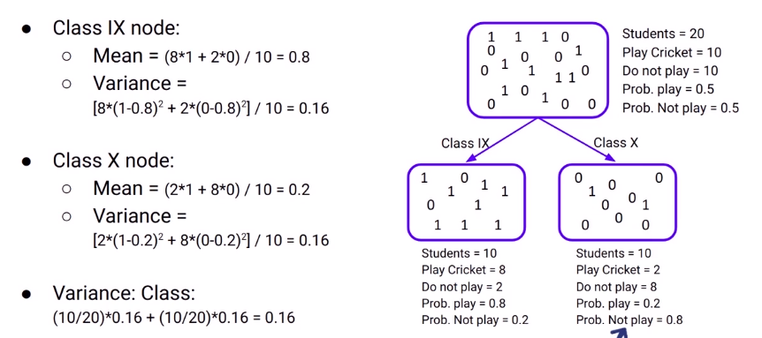
Steps to calculate the variance

Slide 94

Steps to calculate the variance

Slide 95
Question
Let's say you are asked to work on a problem to predict the future sales of a product in a store and decided to use a decision tree model. Which algorithm should be used for splitting?
Gini
Chi-square
Reduction in variance
Information Gain

Slide 96
Question
Let's say you are asked to work on a problem to predict the future sales of a product in a store and decided to use a decision tree model. Which algorithm should be used for splitting?
Gini
Chi-square
Reduction in variance
Information Gain

Slide 97
Create a decision tree using Reduction in variance method.
Day | Weather | Temperature | Humidity | Wind | Play?
1 | Sunny | Hot | High | Weak | No
2 | Cloudy | Hot | High | Weak | Yes
3 | Sunny | Mild | Normal | Strong | Yes
4 | Cloudy | Mild | High | Strong | Yes
5 | Rainy | Mild | High | Strong | No
6 | Rainy | Cool | Normal | Strong | No
7 | Rainy | Mild | High | Weak | Yes
8 | Sunny | Hot | High | Strong | No
9 | Cloudy | Hot | Normal | Weak | Yes
10 | Rainy | Mild | High | Strong | No

Slide 98
Create a decision tree using Reduction in variance method.
A property owner is faced with a choice of:
(a) A large-scale investment (A) to improve her flats. This could produce a substantial pay-off in terms of increased revenue net of costs but will require an investment of £1,400,000. After extensive market research it is considered that there is a 40% chance that a pay-off of £2,500,000 will be obtained, but there is a 60% chance that it will be only £800,000.
(b) A smaller scale project (B) to re-decorate her premises. At £500,000 this is less costly but will produce a lower pay-off. Research data suggests a 30% chance of a gain of £1,000,000 but a 70% chance of it being only £500,000.
(c) Continuing the present operation without change (C). It will cost nothing, but neither will it produce any pay-off. Clients will be unhappy and it will become harder and harder to rent the flats out when they become free.
How will a decision tree help the taking of the decision?

Slide 99

Optimizing Performance of Decision Trees

Slide 100
Overfitting
A statistical model is said to be overfitted, when we train it with a lot of data.
When a model gets trained with so much of data, it starts learning from the noise and inaccurate data entries in our data set.
Then the model does not categorize the data correctly, because of too many details and noise.
The causes of overfitting are the non-parametric and non-linear methods because these types of machine learning algorithms have more freedom in building the model based on the dataset and therefore they can really build unrealistic models.
A solution to avoid overfitting is using a linear algorithm if we have linear data or using the parameters like the maximal depth if we are using decision trees.

Slide 101
Techniques to reduce overfitting
Increase training data.
Reduce model complexity.
Early stopping during the training phase (have an eye over the loss over the training period as soon as loss begins to increase stop training).
Ridge Regularization and Lasso Regularization
Use dropout for neural networks to tackle overfitting.

Slide 102
Underfitting
A statistical model or a machine learning algorithm is said to have underfitting when it cannot capture the underlying trend of the data.
Underfitting destroys the accuracy of our machine learning model.
Its occurrence simply means that our model or the algorithm does not fit the data well enough.
It usually happens when we have less data to build an accurate model and also when we try to build a linear model with a non-linear data.
In such cases the rules of the machine learning model are too easy and flexible to be applied on such minimal data and therefore the model will probably make a lot of wrong predictions.
Underfitting can be avoided by using more data and also reducing the features by feature selection.

Slide 103
Techniques to reduce underfitting
Increase model complexity
Increase number of features, performing feature engineering
Remove noise from the data.
Increase the number of epochs or increase the duration of training to get better results.

Slide 104

Techniques to optimize decision trees
Minimum samples for a node split
Issues:
Too high value can lead to underfit.

Slide 105


Techniques to optimize decision trees
Set minimum samples for the terminal nodes.
Issues:
Too high value can lead to underfit.

Slide 106

Techniques to optimize decision trees
Maximum depth of tree
Issues:
Higher depth can lead to overfitting
Lower depth can lead to underfitting

Slide 107
Question
Which of the following parameter(s) can help to prevent overfitting?
Max depth
Minimum samples for node split
Minimum samples for leaf node
All of the above

Slide 108
Answer
Which of the following parameter(s) can help to prevent overfitting?
Max depth
Minimum samples for node split
Minimum samples for leaf node
All of the above

Slide 109
Question
What is the maximum number of terminal nodes in a decision tree if our training dataset has N samples?
N
B
N/2
2*N
log(N)

Slide 110
Answer
What is the maximum number of terminal nodes in a decision tree if our training dataset has N samples?
N
N/2
2*N
log(N)

Slide 111




Thank You
Sukanta Ghosh
+91-8699583576
Sukanta.19539@lpu.co.in
www.lpu.in

